Slide 1

AZURE-D AVAILABILITY: SQL Server HA IN AND TO THE CLOUD Matt Gordon

Slide 2
ADD THE DATAMINDS SLIDES FROM BENNI’S EMAIL!!!
UPDATE/UPGRADE INFO IN THIS PRESENTATION

Slide 3


Speaker info
Matt Gordon
Architect
Matt.Gordon@insight.com
: @sqlatspeed
www.sqlatspeed.com

Slide 4

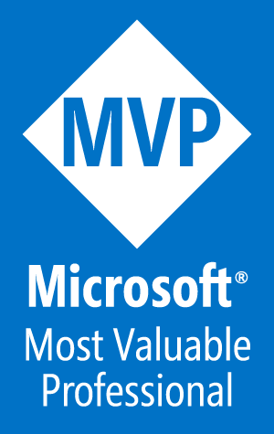
About ME
15+ years of SQL Server experience
Microsoft Data Platform MVP
Friend of Redgate
Managed 24x7 datacenters
Worked on development teams
MCSE: Data Management and Analytics
Local & international community speaker
Leader of Lexington, KY PASS local group

Slide 5
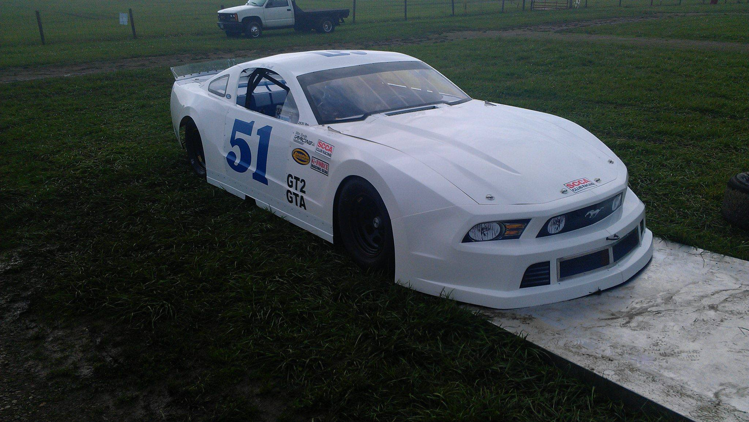
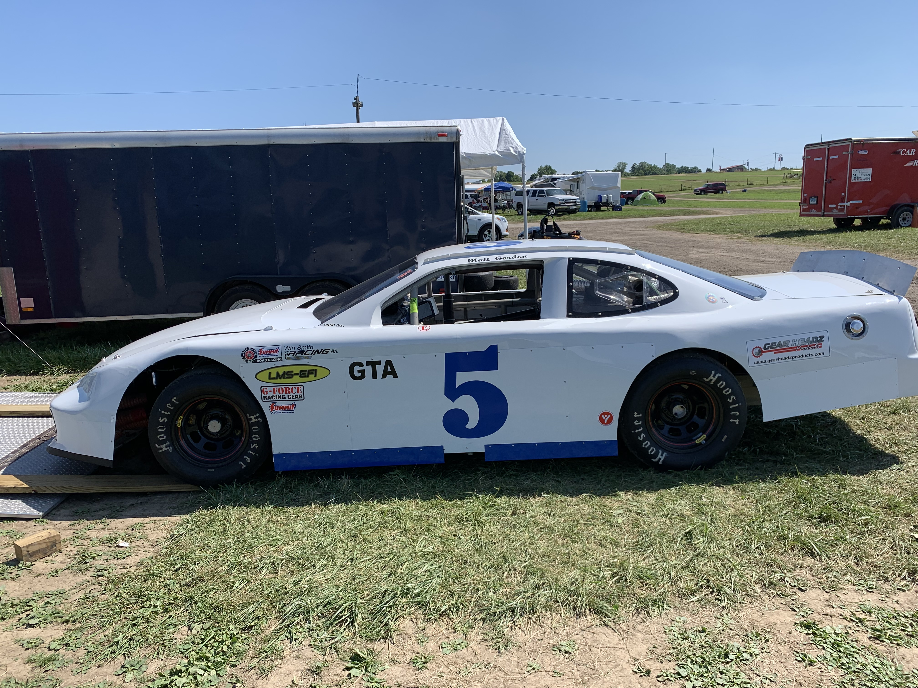
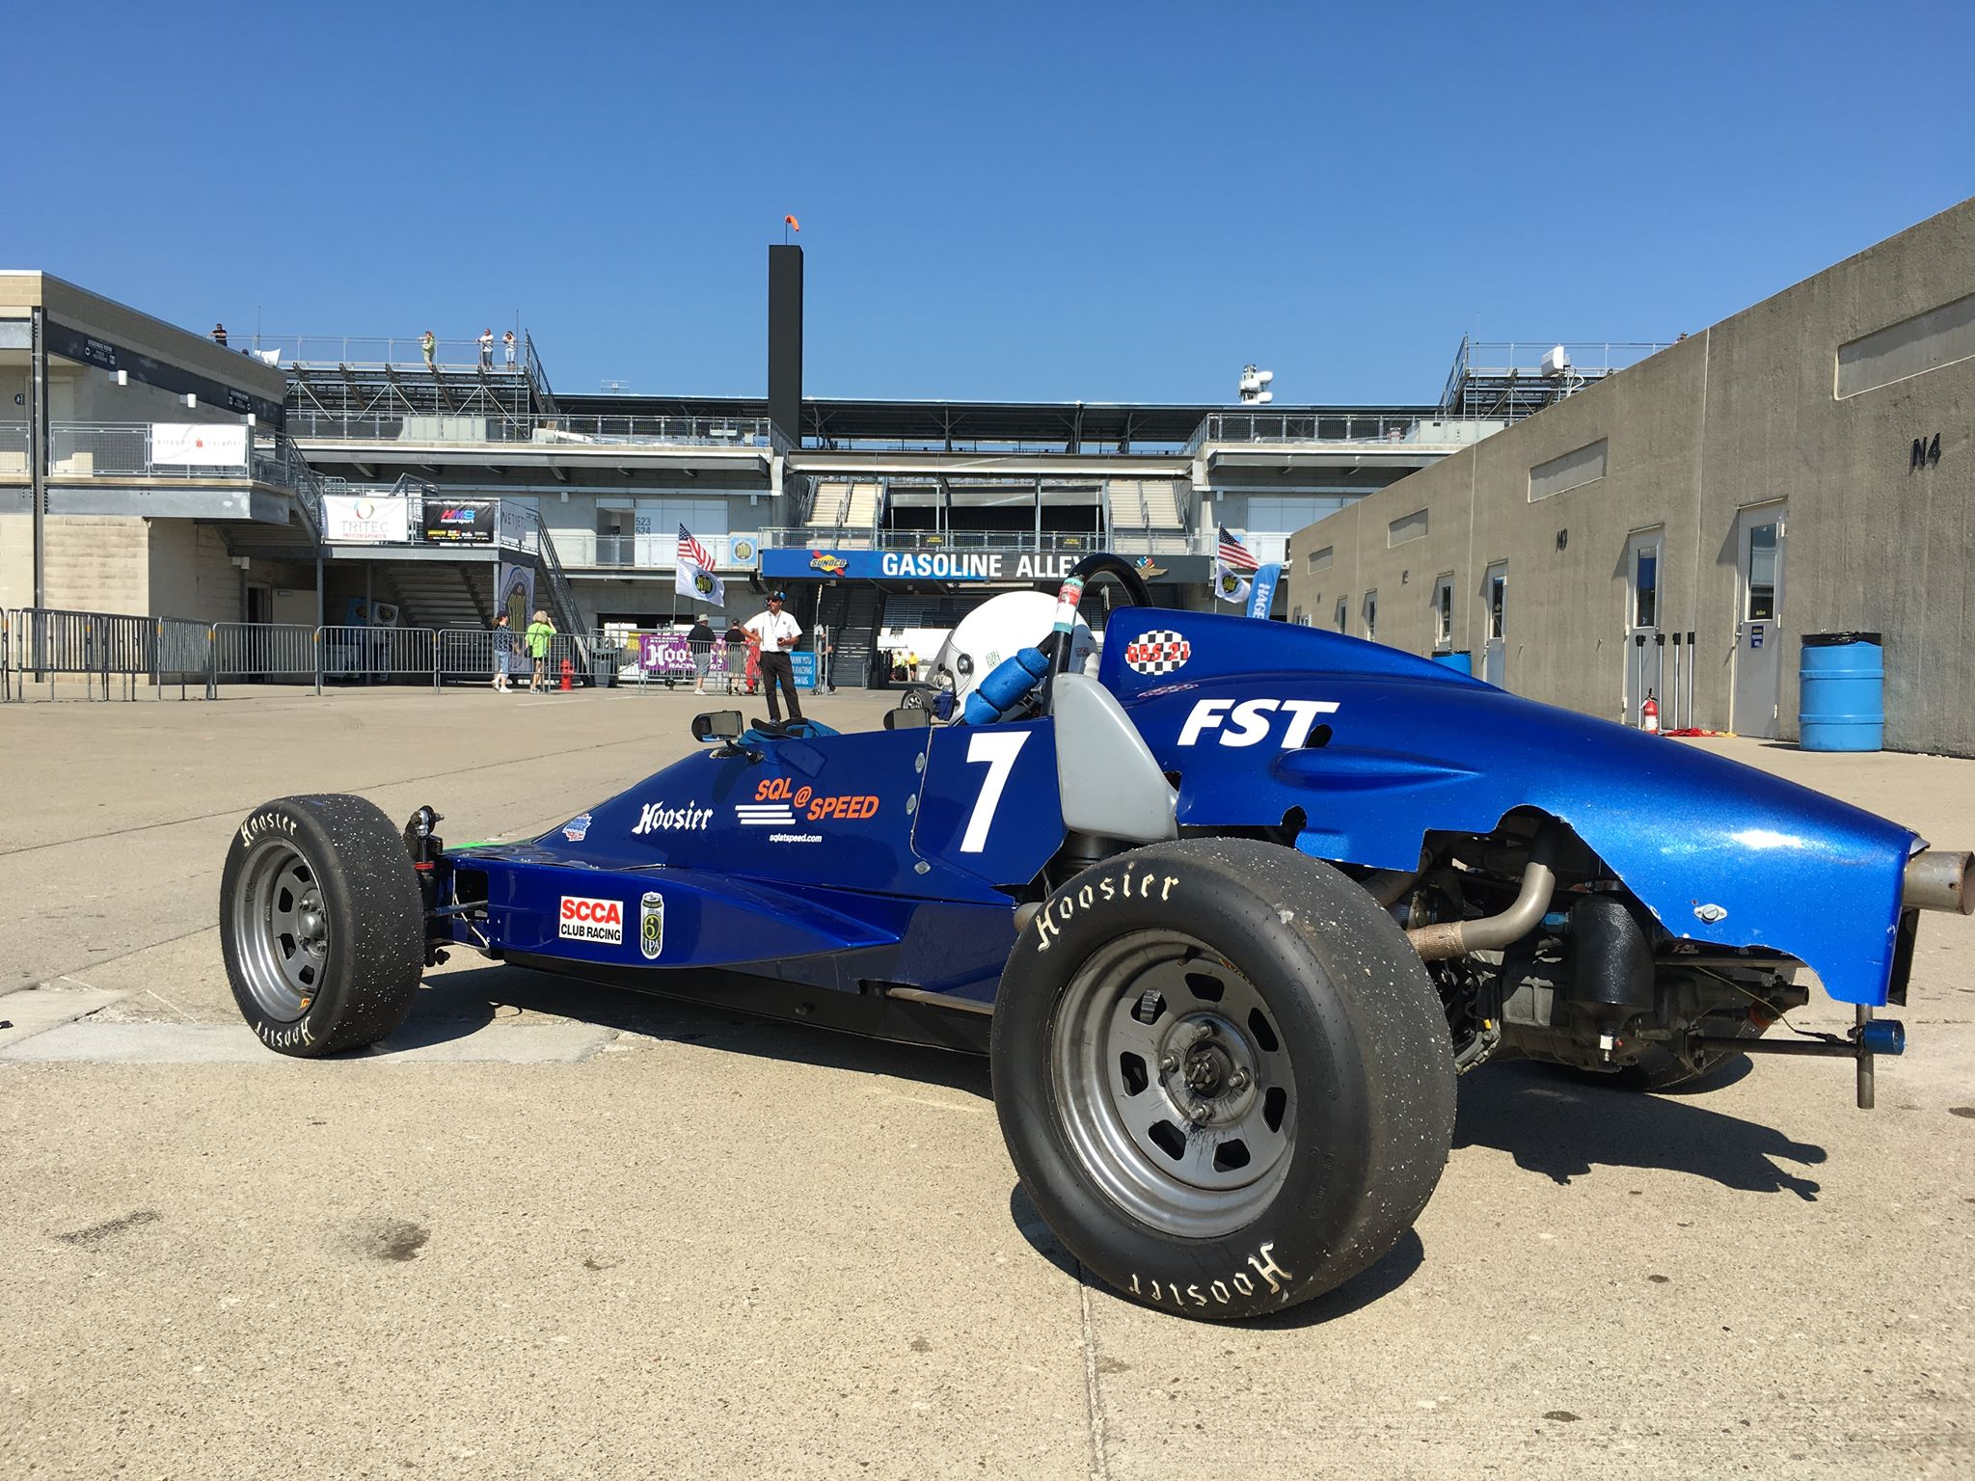
How I picked my twitter handle and domain name

Slide 6
About you
How many first-timers do we have here today?
How many of you are 100% on-premises as of now?
How many are personally looking to utilize Azure?
How many are here because your boss said to cloudify things?
How many are here because you had a downtime incident and want to avoid another one?

Slide 7
agenda
What Is High Availability?
Setting HA Goals
On-premises High Availability Options in SQL Server
Hybrid HA Options
Azure-only HA Options
Takeaways and Q&A

Slide 8
What Is high availability (HA)?
Techopedia.com says…
“[it] refers to systems that are durable and likely to operate continuously”
Layman’s terms
Minimize downtime
Minimize the impact of necessary downtime
May or may not mean the system is always available

Slide 9
Setting high availability goals
HA goals cannot be set in a vacuum
Collaboration with operations
Collaboration with customer-facing teams and personnel
Collaboration with contract personnel
Service level agreements (SLA)
Legal consequences
Corporate consequences

Slide 10

Setting high availability goals
Customer needs
Business dependent
Set expectations based on implementation and support costs

Slide 11

implementing high availability
NOT only a software decision
Choose tools/technology supportable by your team
Technical decision is only part of the battle
Processes are critical
Defined
Repeatable
Testable

Slide 12
Setting high availability goals
Personnel are critical
Best design hamstrung by lack of training
Talent and training are key

Slide 13

On-premises High Availability Options in SQL Server
Let’s have a look…

Slide 14
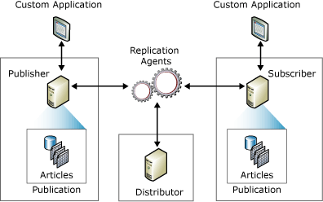
Replication
Copies data and database objects
Publisher, Distributor, and Subscriber

Slide 15
Replication usage scenarios
Report server
Direct intense queries away from primary database
Applicable for data that may not need to be real-time
Remote office
Ensure data lives at another site
Network connectivity may not allow for synchronous data
Data movement
ETL may be kicked off from replicated data
May make data accessible to other groups

Slide 16

Replication pros and cons
Pros
GUI to manage and monitor
Enterprise Edition not required for basic functionality
Control of frequency and amount of data replication
Cons
No automatic failover
Can filter data but performance may suffer
Administrative effort increases exponentially

Slide 17

What is log shipping?
Consists of three steps
Transaction log backup
Log backup sent to one or more secondary servers
Log backup is restored on secondary servers
Monitor server
Optional
Records history and status of configuration

Slide 18
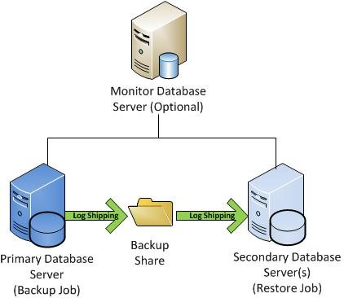
Log shipping diagram

Slide 19
Log shipping pros and cons
Pros
Database-wide DR solution
Possible read-only access to secondary databases
Can set delay between backup and restore
Cons
Secondary data only available when replica in STANDBY status
Manual failover only
Requires broad permissions to move files throughout the network

Slide 20

Database mirroring
SQL Server 2012 release indicated deprecation
Microsoft recommends avoiding this feature for new solutions
Still exists in SQL Server 2016(+)

Slide 21

Database mirroring description
Description
Log records are sent from the principal (primary) database servers to the mirror server
Optional witness server enables automatic failover

Slide 22
Database mirroring usage scenarios
Automatic failover is required but Always On AG or FCI is not feasible
High-safety mode ensures no data loss at mirror
Supporting SQL Server 2005 or 2008

Slide 23
Always on availability groups
Containers for sets of databases to failover together
They are not “Always On” by themselves
Database mirroring on steroids

Slide 24
Always on availability group features
Multi-database failover
Built-in compression and encryption
Automatic page repair
Synchronous or asynchronous data movement options
8 total secondaries, 3 synchronous replicas allowed in SQL Server 2016(+)

Slide 25
Always on availability group pros/cons
Pros
Failover groups of databases
Flexible failover policies
Basic load balancing (SQL 2016 and above)
Database-level health detection (SQL 2016 and above)
Cons
Relies on WSFC so interaction with Windows ops is required
Need to consider load on infrastructure with quantity of data moving
Requires Enterprise Edition (except for Basic Availability Groups)
Constant communication forces review of maintenance procedures

Slide 26
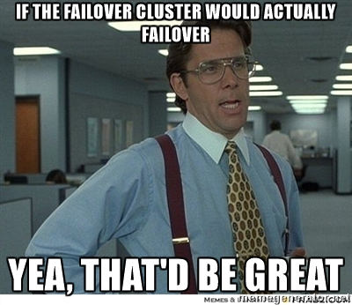
Always on failover cluster instances
Installed via SQL Server Setup
Unit of failover is the SQL Server instance
Requires shared storage
Same virtual network names used regardless of node

Slide 27
HYBRID HA OPTIONS
Real-life scenarios
Most common implementations I see as a consultant
Give you lots of cloud transition options
Let’s take a look…

Slide 28
REPLICATION WITH IAAS VM
Tried and true technology in use
Identical to doing this on-premises other than network portion
Good way to ease into comfort with the cloud

Slide 29
Replication to azure sql database
Azure SQL Database counts as SQL Server!
Azure SQL Database can be a replication subscriber
Eases DBA team into cloud and PaaS interactions
Straightforward setup

Slide 30
Log shipping to azure iaas vm
Popular with customers who want a copy of data stored completely off-site
Straightforward setup
Expands environment without requiring cluster or other complicated infrastructure

Slide 31
Availability Groups with azure replica(s)
Uses Azure as backup datacenter(s)
Requires robust network infrastructure
Good for minimum datacenter proximity requirements
Notes:
Left out mirroring scenarios for a reason – think about why you’re trying to modernize an architecture run on database versions that are basically out of support

Slide 32
Azure-only ha options
Implemented exclusively in Azure
If you want hybrid options you shouldn’t have slept through the last section ☺
I would recommend a comfort level with working in Azure before implementing these options

Slide 33
Azure-only ha options
Database-level high availability via Always On Availability Groups
Domain controller required in Azure for WSFC support
Post SQL Server 2016 versions lessen the need for WSFC support*
Templates available in the gallery to try this out
Some different components than on-premises AG…
Notes:
*on

Slide 34
Unique azure-only ag components
WSFC machines (replicas and file share witness, if used) should be placed in an availability set
Virtual network
ILB (Internal load balancer)
Required if you’re using a listener (and you should)
Do not forget domain controllers!
Build one: https://bit.ly/2D50H67
Notes:
Availability set ensures that resources placed in it are isolated from each other in the datacenter

Slide 35
Azure-only ha options
Instance-level HA via Always On FCIs
Require shared storage
Microsoft officially recommends 3 different ways
2-node FCI using Azure VMs w/attached storage and Windows 2016 Storage Spaces Direct (S2D) for virtual SAN
2-node FCI using Azure VMs w/ 3rd party clustering solution like SIOS DataKeeper
2-node FCI using Azure VMs w/ remote iSCSI Target shared block storage via ExpressRoute
One of these is bad and you shouldn’t do it…

Slide 36
Azure-only ha options
S2D is not recommended in Azure
Performance can be an issue and there are better solutions
The other two options are workable
Think about why you are implementing a shared storage solution in Azure
Is there a better way?
Lift and shift likely not taking advantage of cloud abilities

Slide 37
Azure-only ha options
Can Azure SQL Database help you?
T-SQL support nearly equivalent to on-premises SQL Server
Lack of cross-database queries w/ 3 & 4 part names
Lack of SQL Server Agent
Basic/Standard/General Purpose service tiers separate compute and storage (99.99% SLA)
Premium/Business Critical service tier co-locates compute and storage
Notes:
Lower tiers may experience performance degradation during maintenance
High tiers very similar to an Always On AG under the covers…likely little to no performance degradation
Don’t forget zone-redundant configuration to make your DB very resilient!

Slide 38
Azure-only ha options
High availability is built into Azure SQL Database, but is limited
Failover groups
Geo-replication
Understand your budget and potential issues to determine if additional HA design and features if needed
Notes:
Think of failover groups like AGs – allows you to designate a group of databases (single or MI) to failover together
Geo-replication works for single (not for MI) – allows you to create readable secondaries in same or different datacenters

Slide 39
Azure-only ha options
Can Azure SQL Database Managed Instance help you?
New deployment model of Azure SQL Database
Provides near 100% compatibility with SQL Server on-premises Enterprise Edition
Preserves PaaS capabilities
Automatic patching & version updates
Automated backups
High availability
Using DMS (Data Migration Service) is a popular lift & shift path
Notes:
Service Broker and SQL Server Agent now work

Slide 40
Azure-only ha options
Can Azure SQL Database Hyperscale help you?
Different service tier of Azure SQL Database
Looks and acts just like Azure SQL Database
Backed by Hyperscale scale-out storage technology
Targeted to and optimized for very large workloads
Max capacity of 100 TB
Resiliency provided at the storage level
For true HA, you should provision at least 2 compute nodes
Notes:
Failover is automagic as long as proper nodes are provisioned
Remind of 4 TB/8 TB cap for other versions of Azure PaaS SQL stuff (8 TB for MI (4 TB for Business Critical MI), 4 TB for Azure SQL DB)
Mention Serverless as well

Slide 41
Tired of all this cloud stuff?
ADR (Accelerated Database Recovery) is available in SQL Server 2019
Massive performance boost to database recovery
Improves database availability
Also present in Azure SQL DB and Azure SQL DW (public preview)
Instantaneous transaction rollback
Notes:
Transaction runtime does not affect rollback time

Slide 42
Key takeaways
Communicate within your team
Communicate with all teams involved in design and support
Set expectations for management and team
No perfect answer for every scenario
We lightly touched on Azure SQL Database – can it help?

Slide 43

Questions?

Slide 44
Thanks for ATTENDING!
Matt Gordon
Architect
Matt.Gordon@insight.com
: @sqlatspeed
www.sqlatspeed.com

